Slide 1
3.1 Computer architecture
Purpose of the components in a CPU

Slide 2
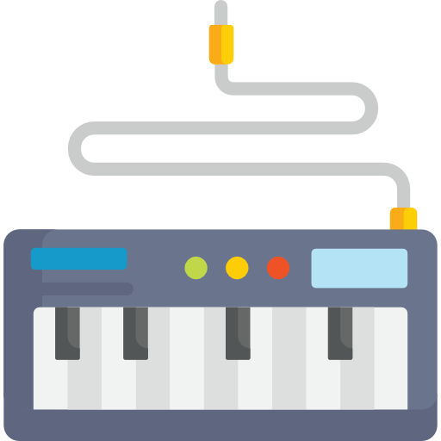
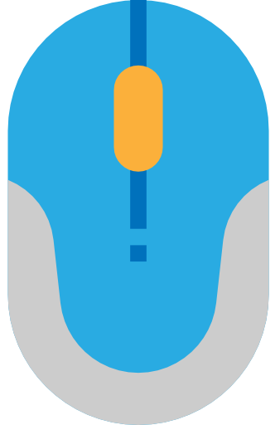
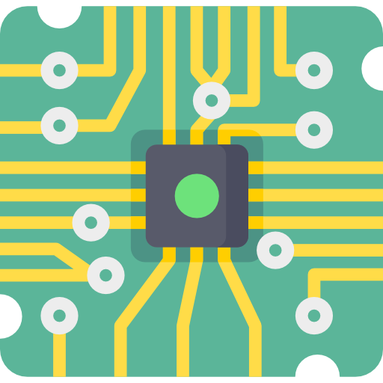




Main components of a computer
Central processing unit (CPU)
Main memory (RAM)
Input devices
Output devices

Slide 3

Internal structure of the CPU
Central processing unit (CPU)
Main memory (RAM)
Program counter
Memory address register
Address | Data
0000 | 0101 0101
0001 | 0001 0110
0010 | 0011 0111
0011 | 1001 0010
0100 | 0000 0000
0101 | 0011 0000
0110 | 0000 0001
0111 | 0000 0000
1000 | 0000 0000
1001 | 0000 0000
1010 | 0000 0000
1011 | 0000 0000
1100 | 0000 0000
1101 | 0000 0000
1110 | 0000 0000
1111 | 0000 0000
Address
bus
Decode unit
Accumulator
Arithmetic logic unit
Memory data register
Data
bus
Current instruction register
Cache
Control
unit
Control
bus

Slide 4

Internal structure of the CPU
Central processing unit (CPU)
Main memory (RAM)
Control unit:
Coordinates all CPU activities.
Directs flow of data between the CPU and other devices.
Coordinates and communicates with all parts of the CPU (orange lines).
Program counter
Memory address register
Address | Data
0000 | 0101 0101
0001 | 0001 0110
0010 | 0011 0111
0011 | 1001 0010
0100 | 0000 0000
0101 | 0011 0000
0110 | 0000 0001
0111 | 0000 0000
1000 | 0000 0000
1001 | 0000 0000
1010 | 0000 0000
1011 | 0000 0000
1100 | 0000 0000
1101 | 0000 0000
1110 | 0000 0000
1111 | 0000 0000
Address
bus
Decode unit
Accumulator
Arithmetic logic unit
Memory data register
Data
bus
Current instruction register
Cache
Control
unit
Control
bus

Slide 5

Internal structure of the CPU
Central processing unit (CPU)
Main memory (RAM)
Program counter (PC):
Holds the address of the next instruction to be executed.
It could be the next instruction in a sequence of instructions or the address to jump to if the current instruction is a command to jump or branch – this would be copied from the current instruction register.
Program counter
Memory address register
Address | Data
0000 | 0101 0101
0001 | 0001 0110
0010 | 0011 0111
0011 | 1001 0010
0100 | 0000 0000
0101 | 0011 0000
0110 | 0000 0001
0111 | 0000 0000
1000 | 0000 0000
1001 | 0000 0000
1010 | 0000 0000
1011 | 0000 0000
1100 | 0000 0000
1101 | 0000 0000
1110 | 0000 0000
1111 | 0000 0000
Address
bus
Decode unit
Accumulator
Arithmetic logic unit
Memory data register
Data
bus
Current instruction register
Cache
Control
unit
Control
bus

Slide 6
Internal structure of the CPU
Central processing unit (CPU)
Main memory (RAM)
Memory address register (MAR):
Holds the address of the memory location that data or an instruction is to be fetched from or written to.
Sends the address to memory down the address bus.
Program counter
Memory address register
Address | Data
0000 | 0101 0101
0001 | 0001 0110
0010 | 0011 0111
0011 | 1001 0010
0100 | 0000 0000
0101 | 0011 0000
0110 | 0000 0001
0111 | 0000 0000
1000 | 0000 0000
1001 | 0000 0000
1010 | 0000 0000
1011 | 0000 0000
1100 | 0000 0000
1101 | 0000 0000
1110 | 0000 0000
1111 | 0000 0000
Address
bus
Decode unit
Accumulator
Arithmetic logic unit
Memory data register
Data
bus
Current instruction register
Cache
Control
unit
Control
bus

Slide 7
Internal structure of the CPU
Central processing unit (CPU)
Main memory (RAM)
Memory data register (MDR):
Used to temporarily store data that is read from or written to memory.
All data to and from memory must travel down the data bus and pass through the MDR.
Program counter
Memory address register
Address | Data
0000 | 0101 0101
0001 | 0001 0110
0010 | 0011 0111
0011 | 1001 0010
0100 | 0000 0000
0101 | 0011 0000
0110 | 0000 0001
0111 | 0000 0000
1000 | 0000 0000
1001 | 0000 0000
1010 | 0000 0000
1011 | 0000 0000
1100 | 0000 0000
1101 | 0000 0000
1110 | 0000 0000
1111 | 0000 0000
Address
bus
Decode unit
Accumulator
Arithmetic logic unit
Memory data register
Data
bus
Current instruction register
Cache
Control
unit
Control
bus

Slide 8
Internal structure of the CPU
Central processing unit (CPU)
Main memory (RAM)
Current instruction register (CIR):
Holds the current instruction being executed.
If the MDR is holding an instruction, it is copied to the current instruction register.
Program counter
Memory address register
Address | Data
0000 | 0101 0101
0001 | 0001 0110
0010 | 0011 0111
0011 | 1001 0010
0100 | 0000 0000
0101 | 0011 0000
0110 | 0000 0001
0111 | 0000 0000
1000 | 0000 0000
1001 | 0000 0000
1010 | 0000 0000
1011 | 0000 0000
1100 | 0000 0000
1101 | 0000 0000
1110 | 0000 0000
1111 | 0000 0000
Address
bus
Decode unit
Accumulator
Arithmetic logic unit
Memory data register
Data
bus
Current instruction register
Cache
Control
unit
Control
bus

Slide 9
Internal structure of the CPU
Central processing unit (CPU)
Main memory (RAM)
Arithmetic logic unit (ALU):
Arithmetic operations on fixed and floating-point numbers:
ADD
SUBTRACT
MULTIPLY
DIVIDE
Right and left bitwise shift operations.
Boolean logic operations:
Comparison
AND
OR
NOT
XOR
Program counter
Memory address register
Address | Data
0000 | 0101 0101
0001 | 0001 0110
0010 | 0011 0111
0011 | 1001 0010
0100 | 0000 0000
0101 | 0011 0000
0110 | 0000 0001
0111 | 0000 0000
1000 | 0000 0000
1001 | 0000 0000
1010 | 0000 0000
1011 | 0000 0000
1100 | 0000 0000
1101 | 0000 0000
1110 | 0000 0000
1111 | 0000 0000
Address
bus
Decode unit
Accumulator
Arithmetic logic unit
Memory data register
Data
bus
Current instruction register
Cache
Control
unit
Control
bus

Slide 10
Internal structure of the CPU
Central processing unit (CPU)
Main memory (RAM)
Accumulator (ACC):
One of several general-purpose registers in modern CPUs.
Often stores data or control information.
The results of calculations carried out by the ALU can be temporarily stored here.
Program counter
Memory address register
Address | Data
0000 | 0101 0101
0001 | 0001 0110
0010 | 0011 0111
0011 | 1001 0010
0100 | 0000 0000
0101 | 0011 0000
0110 | 0000 0001
0111 | 0000 0000
1000 | 0000 0000
1001 | 0000 0000
1010 | 0000 0000
1011 | 0000 0000
1100 | 0000 0000
1101 | 0000 0000
1110 | 0000 0000
1111 | 0000 0000
Address
bus
Decode unit
Accumulator
Arithmetic logic unit
Memory data register
Data
bus
Current instruction register
Cache
Control
unit
Control
bus

Slide 11
Internal structure of the CPU
Central processing unit (CPU)
Main memory (RAM)
Buses:
Address bus: Carries memory addresses that identify where data is being read from or written to.
Data bus: Carries the binary 1s and 0s that make up the actual information being transmitted around the CPU/computer.
Control bus: Carries command and control signals to and from every other component of the CPU/computer.
Program counter
Memory address register
Address | Data
0000 | 0101 0101
0001 | 0001 0110
0010 | 0011 0111
0011 | 1001 0010
0100 | 0000 0000
0101 | 0011 0000
0110 | 0000 0001
0111 | 0000 0000
1000 | 0000 0000
1001 | 0000 0000
1010 | 0000 0000
1011 | 0000 0000
1100 | 0000 0000
1101 | 0000 0000
1110 | 0000 0000
1111 | 0000 0000
Address
bus
Decode unit
Accumulator
Arithmetic logic unit
Memory data register
Data
bus
Current instruction register
Cache
Control
unit
Control
bus

Slide 12

Components of the CPU
The CPU consists of the following components:
Arithmetic logic unit (ALU): Performs calculations and logical decisions.
Control unit (CU): Sends signals to control how data moves around the CPU.
Buses: A collection of wires through which data and instructions are transmitted from one component to another.
Address bus: Unidirectional – carries the addresses that data needs to be written to or read from.
Data bus: Bidirectional – carries actual data or instructions.
Control bus: Bidirectional – carries command and control signals telling components when they should be receiving reads, writes, etc.
Registers: Tiny, super-fast pieces of onboard memory inside the CPU, each with a very specific purpose.
Program counter (PC): Holds the address of the next instruction to be executed.
Memory address register (MAR): Holds the address of the memory location that data or an instruction is to be fetched from or written to.
Memory data register (MDR): Used to temporarily store data that is read from or written to memory.
Current instruction register (CIR): Holds the current instruction being executed.
Accumulator (ACC): One of several general-purpose registers. The results of calculations carried out by the ALU can be temporarily stored here.

Slide 13

3.1 Computer architecture
Going beyond the IGCSE specification

Slide 14

Internal structure of the CPU
Central processing unit (CPU)
Main memory (RAM)
Other important components:
Decode unit
Cache
Status register
Interrupt register
Clock
Program counter
Memory address register
Address | Data
0000 | 0101 0101
0001 | 0001 0110
0010 | 0011 0111
0011 | 1001 0010
0100 | 0000 0000
0101 | 0011 0000
0110 | 0000 0001
0111 | 0000 0000
1000 | 0000 0000
1001 | 0000 0000
1010 | 0000 0000
1011 | 0000 0000
1100 | 0000 0000
1101 | 0000 0000
1110 | 0000 0000
1111 | 0000 0000
Address
bus
Decode unit
Accumulator
Arithmetic logic unit
Memory data register
Data
bus
Current instruction register
Clock
Cache
Status register
Control
unit
Control
bus
Interrupt register

Slide 15
Internal structure of the CPU
Central processing unit (CPU)
Main memory (RAM)
Decode unit:
In essence, a piece of logic that is presented with a sequence of bits that have been fetched from memory.
In an abstract way, you can think of it as a lookup table.
Prepares the execution of an instruction by looking up the relevant binary code in a table so the CPU knows what to do.
Commands available in the decode unit will be specific to the instruction-set architecture of the processor.
Program counter
Memory address register
Address | Data
0000 | 0101 0101
0001 | 0001 0110
0010 | 0011 0111
0011 | 1001 0010
0100 | 0000 0000
0101 | 0011 0000
0110 | 0000 0001
0111 | 0000 0000
1000 | 0000 0000
1001 | 0000 0000
1010 | 0000 0000
1011 | 0000 0000
1100 | 0000 0000
1101 | 0000 0000
1110 | 0000 0000
1111 | 0000 0000
Address
bus
DECODE UNIT
OPCODE OPERAND | INSTRUCTION
0000 0000 | end
0001 address | add
0010 address | subtract
0011 address | store
0101 address | load
0110 address | branch always
0111 address | branch if ACC=0
1000 address | branch if ACC>=0
1001 0001 | input
1001 0010 | output
Accumulator
Arithmetic logic unit
Memory data register
Data
bus
Current instruction register
Clock
Cache
Status register
Control
unit
Control
bus
Interrupt register

Slide 16
Internal structure of the CPU
Central processing unit (CPU)
Main memory (RAM)
Status register:
Contains information about the state of the processor.
Program counter
Memory address register
Address | Data
0000 | 0101 0101
0001 | 0001 0110
0010 | 0011 0111
0011 | 1001 0010
0100 | 0000 0000
0101 | 0011 0000
0110 | 0000 0001
0111 | 0000 0000
1000 | 0000 0000
1001 | 0000 0000
1010 | 0000 0000
1011 | 0000 0000
1100 | 0000 0000
1101 | 0000 0000
1110 | 0000 0000
1111 | 0000 0000
Address
bus
Decode unit
Accumulator
Arithmetic logic unit
Memory data register
Data
bus
Current instruction register
Clock
Cache
Status register
Control
unit
Control
bus
Interrupt register

Slide 17
Internal structure of the CPU
Central processing unit (CPU)
Main memory (RAM)
Clock:
Electronic unit that synchronises related components by generating pulses at a constant rate.
Clock speed is the frequency at which the internal clock generates pulses.
Program counter
Memory address register
Address | Data
0000 | 0101 0101
0001 | 0001 0110
0010 | 0011 0111
0011 | 1001 0010
0100 | 0000 0000
0101 | 0011 0000
0110 | 0000 0001
0111 | 0000 0000
1000 | 0000 0000
1001 | 0000 0000
1010 | 0000 0000
1011 | 0000 0000
1100 | 0000 0000
1101 | 0000 0000
1110 | 0000 0000
1111 | 0000 0000
Address
bus
Decode unit
Accumulator
Arithmetic logic unit
Memory data register
Data
bus
Current instruction register
Clock
Cache
Status register
Control
unit
Control
bus
Interrupt register

Slide 18
Internal structure of the CPU
Central processing unit (CPU)
Main memory (RAM)
Interrupt register (IR):
Checked by the CPU to see if an interrupt is waiting to be processed.
If it is, a software process known as the interrupt service routine (ISR) interrupts the current active process.
Program counter
Memory address register
Address | Data
0000 | 0101 0101
0001 | 0001 0110
0010 | 0011 0111
0011 | 1001 0010
0100 | 0000 0000
0101 | 0011 0000
0110 | 0000 0001
0111 | 0000 0000
1000 | 0000 0000
1001 | 0000 0000
1010 | 0000 0000
1011 | 0000 0000
1100 | 0000 0000
1101 | 0000 0000
1110 | 0000 0000
1111 | 0000 0000
Address
bus
Decode unit
Accumulator
Arithmetic logic unit
Memory data register
Data
bus
Current instruction register
Clock
Cache
Status register
Control
unit
Control
bus
Interrupt register

Slide 19
Internal structure of the CPU
Central processing unit (CPU)
Main memory (RAM)
Cache:
A small area of memory, often located on or near the CPU, that provides fast access to frequently used instructions and data.
Physically closer to the CPU than RAM and faster to access but has a smaller capacity.
Program counter
Memory address register
Address | Data
0000 | 0101 0101
0001 | 0001 0110
0010 | 0011 0111
0011 | 1001 0010
0100 | 0000 0000
0101 | 0011 0000
0110 | 0000 0001
0111 | 0000 0000
1000 | 0000 0000
1001 | 0000 0000
1010 | 0000 0000
1011 | 0000 0000
1100 | 0000 0000
1101 | 0000 0000
1110 | 0000 0000
1111 | 0000 0000
Address
bus
Decode unit
Accumulator
Arithmetic logic unit
Memory data register
Data
bus
Current instruction register
Clock
Cache
Status register
Control
unit
Control
bus
Interrupt register

Slide 20


